Slide 1
OPPO K13 First Sales ARS Survey Findings
May (End) 2025

Slide 2
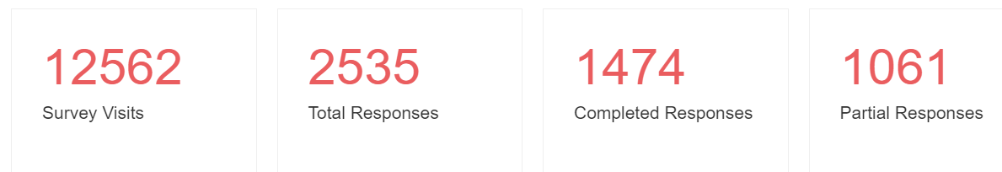
Response Statistics

Slide 3
Basic Information
Age Distribution Of Participants
Age | Count | %
18-24 years | 665 | 45%
25-29 years | 284 | 19%
30-34 years | 174 | 12%
35-39 years | 98 | 7%
40-49 years | 85 | 6%
50-59 years | 13 | 1%
Less than 18 years | 151 | 10%
Refuse to answer | 4 | 0%
Grand Total | 1474 | 100%

Slide 4
Present & Previous Phone Brand / Reason for Change

Slide 5
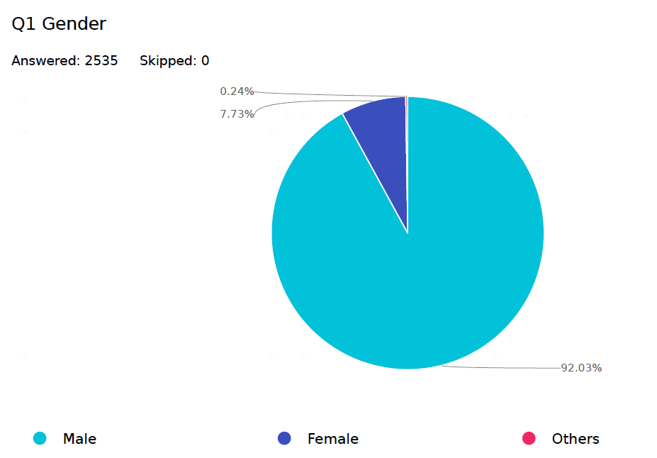
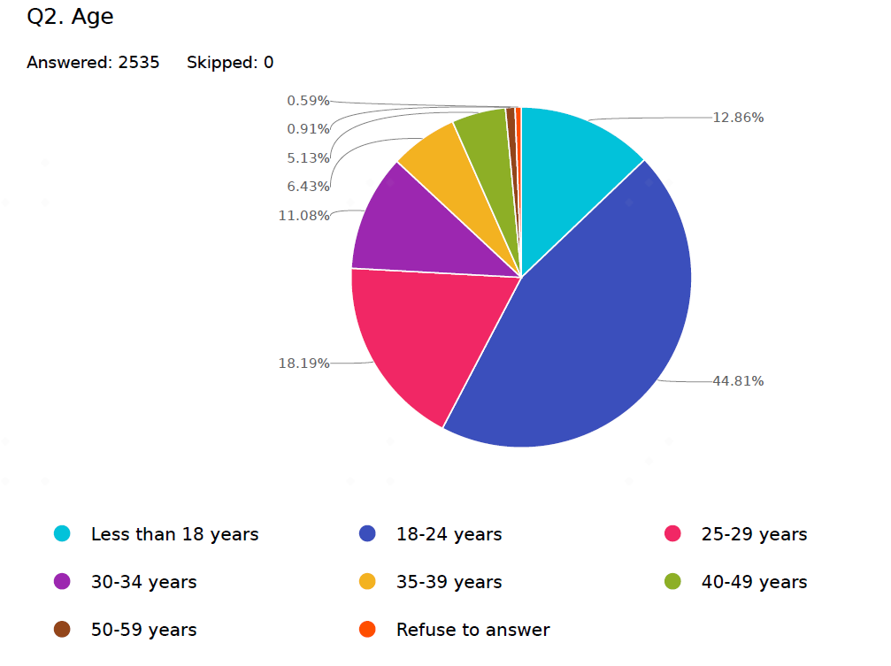
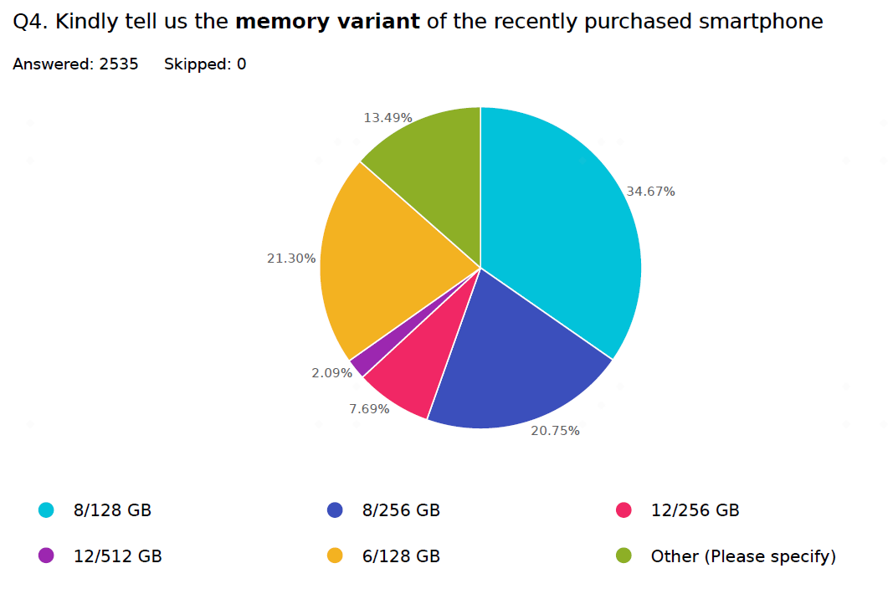
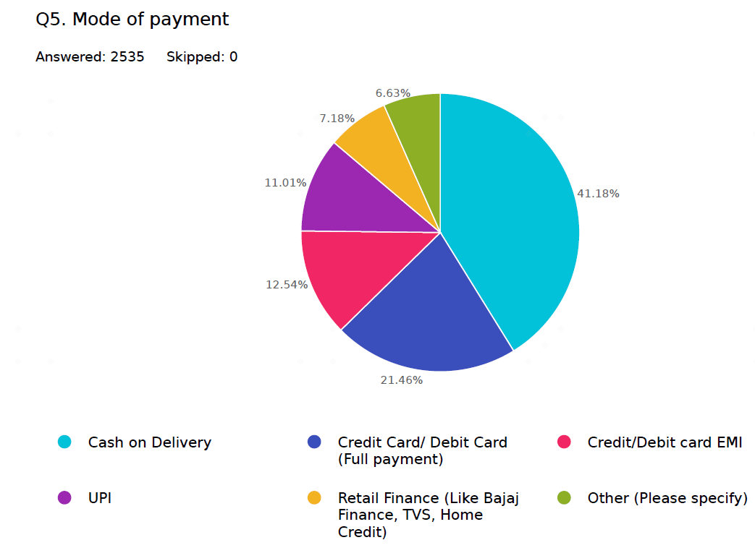

Slide 6
Payment Mode used by Different age group and Occupation
Age Group | Cash on Delivery | % | Credit Card/ Debit Card (Full payment) | % | Credit/Debit card EMI | % | Retail Finance (Like Bajaj Finance, TVS, Home Credit) | % | UPI | % | Other (Please specify) | % | Grand Total
18-24 years | 275 | 53% | 134 | 36% | 58 | 30% | 53 | 50% | 98 | 52% | 47 | 52% | 665 | 45%
25-29 years | 78 | 15% | 83 | 22% | 46 | 23% | 24 | 22% | 44 | 23% | 9 | 10% | 284 | 19%
30-34 years | 41 | 8% | 63 | 17% | 36 | 18% | 10 | 9% | 20 | 11% | 4 | 4% | 174 | 12%
35-39 years | 25 | 5% | 29 | 8% | 19 | 10% | 8 | 7% | 11 | 6% | 6 | 7% | 98 | 7%
40-49 years | 17 | 3% | 33 | 9% | 19 | 10% | 3 | 3% | 7 | 4% | 6 | 7% | 85 | 6%
50-59 years | 4 | 1% | 5 | 1% | 2 | 1% | 1 | 1% | 1 | 1% | 0 | 0% | 13 | 1%
Less than 18 years | 75 | 15% | 28 | 7% | 16 | 8% | 8 | 7% | 6 | 3% | 18 | 20% | 151 | 10%
Refuse to answer | 2 | 0% |  | 0% |  | 0% |  | 0% | 2 | 1% | 0 | 0% | 4 | 0%
Grand Total | 517 |  | 375 |  | 196 |  | 107 |  | 189 |  | 90 |  | 1474
 | 35% |  | 25% |  | 13% |  | 7% |  | 13% |  | 6% |  | 100%
Row Labels | Cash on Delivery | % | Credit Card/ Debit Card (Full payment) | % | Credit/Debit card EMI | % | Retail Finance (Like Bajaj Finance, TVS, Home Credit) | % | UPI | % | Other (Please specify) | % | Grand Total
College Student | 187 | 36% | 91 | 24% | 35 | 18% | 23 | 21% | 67 | 35% | 25 | 28% | 428 | 29%
School Student | 84 | 16% | 30 | 8% | 10 | 5% | 10 | 9% | 12 | 6% | 18 | 20% | 164 | 11%
Private Employee (MNC) | 70 | 14% | 101 | 27% | 74 | 38% | 36 | 34% | 35 | 19% | 15 | 17% | 331 | 22%
Small Business owners | 33 | 6% | 19 | 5% | 17 | 9% | 6 | 6% | 11 | 6% | 4 | 4% | 90 | 6%
Workers - manufacturing, maintenance, construction, transportation etc | 22 | 4% | 8 | 2% | 7 | 4% | 8 | 7% | 6 | 3% | 2 | 2% | 53 | 4%
Government employee | 21 | 4% | 40 | 11% | 10 | 5% | 4 | 4% | 13 | 7% | 4 | 4% | 92 | 6%
Housewife | 17 | 3% | 7 | 2% | 4 | 2% | 1 | 1% | 3 | 2% | 4 | 4% | 36 | 2%
Professional (Doctor, lawyer, CA etc.) | 14 | 3% | 12 | 3% | 7 | 4% | 2 | 2% | 15 | 8% | 1 | 1% | 51 | 3%
Workers – Drivers (Uber/Ola/Rapido/Auto), Delivery people(Zomato, Swiggy, Flipkart, Amazon etc), Sales promotors in retail. | 14 | 3% | 6 | 2% | 7 | 4% | 6 | 6% | 2 | 1% | 2 | 2% | 37 | 3%
Senior + Middle level Management in office | 9 | 2% | 11 | 3% | 7 | 4% | 1 | 1% | 6 | 3% | 0 | 0% | 34 | 2%
General workers (waiters etc.) | 7 | 1% | 6 | 2% | 2 | 1% |  | 0% | 1 | 1% | 2 | 2% | 18 | 1%
Business man （Real estate intermediary, engaged in the financial industry, insurance sales, automotive consumer services） | 6 | 1% | 6 | 2% | 2 | 1% | 1 | 1% | 1 | 1% | 1 | 1% | 17 | 1%
Small Business owner (Less than 10 employees) | 6 | 1% | 6 | 2% | 1 | 1% | 3 | 3% | 4 | 2% | 1 | 1% | 21 | 1%
Employees engaged in agriculture, animal husbandry and forestry （ Who will use the app like PMKISAN Gol， Mandi Central） | 4 | 1% | 3 | 1% | 2 | 1% |  | 0% | 2 | 1% | 1 | 1% | 12 | 1%
New Blue collar ( Swiggy, uber etc.) | 2 | 0% |  | 0% |  | 0% |  | 0% |  | 0% | 0 | 0% | 2 | 0%
Entrepreneur (More than 10 employees) | 1 | 0% | 7 | 2% |  | 0% | 1 | 1% | 2 | 1% | 2 | 2% | 13 | 1%
Others | 20 | 4% | 22 | 6% | 11 | 6% | 5 | 5% | 9 | 5% | 8 | 9% |  | 0%
Grand Total | 517 |  | 375 |  | 196 |  | 107 |  | 189 |  | 90 |  | 1474
 | 35% |  | 25% |  | 13% |  | 7% |  | 13% |  | 6% |  | 100%

Slide 7
K13 Acceptors - Scenarios 1 & 2
Scenario 1 : K13 Acceptor who considered other phones too
S1: if Q3 (Model Purchased) = K13 & Q6 (other models considered) = Yes then
after Q8-->Q9 to Q11 (Purchase Journey) -->
Q12 to Q21 (if Q21 (4 days usage) is yes then
Q22-23 (K13 Acceptor Questions)
Q38 to Q47 - Customer Information
37 of 61 i.e. 61% of K13 Buyers considered other phones too
Purchase Journey
Post Usage feedback (after 4 days use)
3) Acceptor Questions
Scenario 2 : K13 Acceptor who didn't consider other phones
S2: if Q3 (Model Purchased) = K13 & Q6 (other models considered) = No , then after Q6 -->
Q9 to Q11 (Purchase Journey) -->
Q12 to Q23 Acceptor Questions)
Q38 to Q47 - Customer Information
24 of 61 i.e. 39% of K13 Buyers didn’t considered other phones
Purchase Journey
Post Usage feedback (after 4 days use)
3) Acceptor Questions

Slide 8
K13 Rejectors - Scenarios 3 & 4
Scenario 3 - K13 Rejector who Considered K13
S3: if Q3=not K13 but Q7 = K13 then after Q8-->
Q9 to Q11 (Purchase Journey) -->
Q24 to Q31 (Rejector who considered K13)
Q35 to Q37 (Rejector's Post Usage feedback)
Q38 to Q45 - Customer Information (not asking contact)
324 Of 710 i.e. 46% of K13 Rejectors who considered K13
Purchase Journey
Rejector who considered K13
Rejector‘s Post Usage feedback of other phone
Scenario 4 - K13 Rejector who didn't considered K13 but knows about it
S4: if Q3=not K13 , Q7 not K13 but Q32 = Yes (knows Oppo K13) then after Q8-->
Q32 to Q34 (platform & non consideration reason)
Q35 to Q37 (Rejector's Post Usage feedback)
Q38 to Q45 - Customer Information
386 of 710 i.e. 54% of K13 Rejector who didn't considered K13 but knows about it
Platform information & K13 non consideration reason
Rejector‘s Post Usage feedback of other phone

Slide 9
K13 Rejectors - Scenarios 3 & 4
Scenario 5 - K13 Rejector who didn't consider K13 since he doesn't knows about it
S4: if Q3=not K13 , Q7 not K13 and Q32 = No (knows Oppo K13) then after Q8-->
Q32 = NoQ35 to Q37 (Rejector's Post Usage feedback)
Q38 to Q45 - Customer Information (not includes contact)
552- K13 Rejector who didn't considered K13 since doesn’t know about it
Platform information & K13 non consideration reason
Rejector‘s Post Usage feedback of other phone

Slide 10
K13 Acceptor Rejector Categories and Statistics
K13 - Acceptor / Rejector Stats |  |  |  |  |  |  |  |  | Display Logic of Survey for Acceptor/Rejector
 |  |  |  |  |  |  |  |  | Q3 | Q6 | Q7 | Q8 | Q32
S.No. | Acceptor (Buyer of K13) / Rejectors |  |  |  | Category of Acceptor / Rejector | Count | % within Acceptors /Rejectors | % with total as base | Model Bought | Other Model considered (Yes /No) | Name of Models considered | 2nd best Choice (most compared with) | Knew K13 or not (Yes /No)
1 | Acceptors | K13 Buyers | 61 | 4% | K13 Buyers who didn't consider another phone | 24 | 39% | 2% | K13 | Yes | - | - | -
2 |  |  |  |  | K13 Buyers who considered another phone | 37 | 61% | 3% | K13 | No | - | - | -
3 | Rejectors | Considered K13 but didn't buy | 152 | 10% | Considered K13 as second choice (model most closely compared with) | 63 | 41% | 4% | Not K13 | Yes | K13++ | K13 | -
 |  |  |  |  | Considered K13 but it wan't second best choice | 89 | 59% | 6% | Not K13 | Yes | K13++ | Not K13
4 |  | Didn't Consider K13 | 1262 | 86% | Didn't consider K13 but Knows about it | 386 | 31% | 26% | Not K13 | Yes | Not K13 | Not K13 | Yes
5 |  |  |  |  | Didn't consider K13 since doesn't Know about it | 324 | 26% | 22% | Not K13 | Yes | Not K13 | Not K13 | No
 |  |  |  |  | Didn't consider any other models | 552 | 44% | 37% | Not K13 | No | - | - | -
Grand Total |  |  | 1474 | 100% |  | 1474 | - | 100%

Slide 11
Findings from Acceptors (K13 Buyers) Survey Data:
For K13 Buyers , All other Models Considered (Q7)
Brand | Considered models | Qty
Realme | Realme P3 | 12
Vivo | Vivo T4x | 9
Motorola | Moto Edge 50 Fusion | 7
Motorola | Moto G85 | 6
Nothing | CMF Phone 1 | 6
Realme | Realme P3x | 6
Vivo | Vivo T4 | 6
Motorola | Moto Edge 60 Fusion | 5
Nothing | Nothing Phone 3a | 5
Vivo | Vivo T3x | 4
Nothing | Nothing Phone 2a | 3
Oneplus | One Plus Nord CE3 Lite | 3
Samsung | Samsung M35 | 3
Vivo | Vivo T3 | 3
iQOO | iQoo Z10 | 2
Oneplus | One Plus Nord CE4 Lite | 2
Realme | Realme P2pro | 2
iQOO | iQoo Z10x | 1
Motorola | Moto Edge 60 Stylus | 1
Vivo | Vivo T3 Pro | 1
Brands of Considered Models for K13 Buyers |  | Qty
Vivo | 23 | 26%
Realme | 20 | 23%
Motorola | 19 | 22%
Nothing | 14 | 16%
Oneplus | 5 | 6%
iQOO | 3 | 3%
Samsung (Only Samsung M35) | 3 | 3%
Total | 87 | 100%
All Models Considered (Q7)
Brand | Model | Qty
Nothing | Nothing Phone 3a | 173
Oppo | Oppo K13 | 160
Motorola | Moto Edge 50 Fusion | 154
Motorola | Moto Edge 60 Fusion | 152
Samsung | Samsung M35 | 134
Nothing | CMF Phone 1 | 132
Vivo | Vivo T4x | 115
Nothing | Nothing Phone 2a | 114
Motorola | Moto G85 | 112
Motorola | Moto Edge 60 Stylus | 109
Vivo | Vivo T4 | 105
Realme | Realme P3 | 103
Vivo | Vivo T3 Pro | 103
iQOO | iQoo Z10 | 97
Oneplus | One Plus Nord CE4 Lite | 94
Vivo | Vivo T3x | 85
Vivo | Vivo T3 | 79
Oneplus | One Plus Nord CE3 Lite | 77
iQOO | iQoo Z10x | 75
Realme | Realme P3x | 74
iQOO | iQoo Z9s | 71
Realme | Realme P2pro | 63
Q7. Brands of All Considered Models
Motorola | 527 | 22%
Vivo | 487 | 20%
Nothing | 419 | 18%
iQOO | 243 | 10%
Realme | 240 | 10%
Oneplus | 171 | 7%
Oppo (only Oppo K13) | 160 | 7%
Samsung (Only Samsung M35) | 134 | 6%
Total | 2381 | 100%

Slide 12
Findings from Acceptors (K13 Buyers) Survey Data(Contd.):
N=1474
First Channel
Information Channel
Second Channel

Slide 13
Findings from Acceptors (K13 Buyers) Survey Data(Contd.):

Slide 14
Findings from Acceptors (K13 Buyers) Survey Data (contd):

Slide 15
Rejectors (K13 Rejectors)

Slide 16
Findings from Rejectors (K13 Rejectors who Considered K13 as second choice (model most closely compared with))

Slide 17
Brands | Count | %
Vivo | 242 | 16%
Moto | 220 | 15%
Realme | 190 | 13%
Xiaomi | 188 | 13%
Nothing | 141 | 10%
Samsung | 137 | 9%
Oppo | 116 | 8%
iQOO | 70 | 5%
Oneplus | 50 | 3%
Transsion | 44 | 3%
Apple | 24 | 2%
Google | 5 | 0%
Lava | 3 | 0%
Lenovo | 2 | 0%
Nokia | 2 | 0%
Alcatel | 1 | 0%
Huawei | 1 | 0%
Others | 38 | 3%
Grand Total | 1474 | 100%
Occupation | Count | %
College Student | 434 | 29%
Private Employee (MNC) | 331 | 22%
School Student | 167 | 11%
Small Business owners | 95 | 6%
Government employee | 92 | 6%
Professional (Doctor, lawyer, CA etc.) | 63 | 4%
Workers - manufacturing, maintenance, construction, transportation etc | 53 | 4%
Workers – Drivers (Uber/Ola/Rapido/Auto), Delivery people(Zomato, Swiggy, Flipkart, Amazon etc), Sales promotors in retail. | 39 | 3%
Housewife | 37 | 3%
Senior + Middle level Management in office | 34 | 2%
Small Business owner (Less than 10 employees) | 21 | 1%
General workers (waiters etc.) | 18 | 1%
Business man （Real estate insurance sales,etc) | 17 | 1%
Entrepreneur (More than 10 employees) | 13 | 1%
Farming and Agriculture | 16 | 1%
Other (Please specify) | 44 | 3%
Grand Total | 1474 | 100%
Age | Count | %
18-24 years | 665 | 45%
25-29 years | 284 | 19%
30-34 years | 174 | 12%
35-39 years | 98 | 7%
40-49 years | 85 | 6%
50-59 years | 13 | 1%
Less than 18 years | 151 | 10%
Refuse to answer | 4 | 0%
Grand Total | 1474 | 100%

Slide 18
Occupation | Vivo |  | Moto |  | Realme |  | Xiaomi |  | Nothing |  | Samsung |  | OPPO |  | iQOO |  | Oneplus |  | Transsion |  | Total
College Student | 67 | 28% | 60 | 27% | 68 | 36% | 60 | 32% | 45 | 32% | 37 | 27% | 35 | 30% | 25 | 36% | 8 | 16% | 16 | 37% | 421 | 30%
Private Employee (MNC) | 54 | 22% | 58 | 26% | 44 | 23% | 30 | 16% | 37 | 26% | 27 | 20% | 24 | 21% | 16 | 23% | 16 | 32% | 8 | 19% | 314 | 23%
School Student | 44 | 18% | 11 | 5% | 20 | 11% | 22 | 12% | 10 | 7% | 15 | 11% | 18 | 16% | 8 | 11% | 1 | 2% | 1 | 2% | 150 | 11%
Government employee | 13 | 5% | 11 | 5% | 11 | 6% | 10 | 5% | 9 | 6% | 13 | 9% | 7 | 6% | 7 | 10% | 5 | 10% | 3 | 7% | 89 | 6%
Small Business owners | 15 | 6% | 21 | 10% | 14 | 7% | 8 | 4% | 10 | 7% | 5 | 4% | 0 | 0% | 3 | 4% | 1 | 2% | 3 | 7% | 80 | 6%
Professional (Doctor, lawyer, CA etc.) | 6 | 2% | 13 | 6% | 3 | 2% | 9 | 5% | 10 | 7% | 11 | 8% | 3 | 3% | 1 | 1% | 2 | 4% | 6 | 14% | 64 | 5%
Workers - manufacturing, maintenance, construction, transportation etc | 9 | 4% | 5 | 2% | 8 | 4% | 8 | 4% | 8 | 6% | 6 | 4% | 5 | 4% | 0 | 0% | 2 | 4% | 2 | 5% | 53 | 4%
Housewife | 3 | 1% | 4 | 2% | 3 | 2% | 11 | 6% | 1 | 1% | 5 | 4% | 6 | 5% | 2 | 3% | 0 | 0% | 2 | 5% | 37 | 3%
Workers – Drivers (Uber/Ola/Rapido/Auto), Delivery people(Zomato, Swiggy, Flipkart, Amazon etc), Sales promotors in retail. | 4 | 2% | 8 | 4% | 3 | 2% | 6 | 3% |  | 0% | 3 | 2% | 6 | 5% | 0 | 0% | 4 | 8% | 0 | 0% | 34 | 2%
Senior + Middle level Management in office | 7 | 3% | 6 | 3% | 3 | 2% | 3 | 2% | 3 | 2% | 2 | 1% | 1 | 1% | 1 | 1% | 3 | 6% | 0 | 0% | 29 | 2%
Small Business owner (Less than 10 employees) | 4 | 2% | 7 | 3% |  | 0% | 2 | 1% | 1 | 1% | 3 | 2% | 4 | 3% | 4 | 6% | 3 | 6% | 0 | 0% | 28 | 2%
General workers (waiters etc.) | 2 | 1% | 2 | 1% | 2 | 1% | 3 | 2% | 2 | 1% | 4 | 3% | 3 | 3% | 0 | 0% | 0 | 0% | 0 | 0% | 18 | 1%
Business man （Real estate intermediary, engaged in the financial industry, insurance sales, automotive consumer services） | 3 | 1% | 2 | 1% | 3 | 2% | 2 | 1% | 2 | 1% | 2 | 1% | 1 | 1% |  | 0% | 2 | 4% | 0 | 0% | 17 | 1%
Employees engaged in agriculture, animal husbandry and forestry （ Who will use the app like PMKISAN Gol， Mandi Central） | 2 | 1% | 2 | 1% | 3 | 2% | 6 | 3% | 0 | 0% | 1 | 1% | 1 | 1% | 1 | 1% | 0 | 0% | 0 | 0% | 16 | 1%
Entrepreneur (More than 10 employees) | 1 | 0% | 4 | 2% | 1 | 1% | 1 | 1% | 2 | 1% | 0 | 0% | 1 | 1% | 1 | 1% | 0 | 0% | 1 | 2% | 12 | 1%
Other (Please specify) | 6 | 2% | 5 | 2% | 4 | 2% | 6 | 3% | 1 | 1% | 3 | 2% | 1 | 1% | 1 | 1% | 3 | 6% | 1 | 2% | 31 | 2%
Grand Total | 241 | 100% | 219 | 100% | 190 | 100% | 187 | 100% | 141 | 100% | 137 | 100% | 116 | 100% | 70 | 100% | 50 | 100% | 43 | 100% | 1394 | 100%
 |  |  |  |  |  |  |  |  |  |  |  |  |  |  |  |  |  |  |  |  | 95% of 1474

Slide 19
Occupation | Vivo |  | Moto |  | Realme |  | Xiaomi |  | Nothing |  | Samsung |  | OPPO |  | iQOO |  | Oneplus |  | Transsion |  | Total
College Student | 67 | 16% | 60 | 14% | 68 | 16% | 60 | 14% | 45 | 11% | 37 | 9% | 35 | 8% | 25 | 6% | 8 | 2% | 16 | 4% | 421 | 30%
Private Employee (MNC) | 54 | 17% | 58 | 18% | 44 | 14% | 30 | 10% | 37 | 12% | 27 | 9% | 24 | 8% | 16 | 5% | 16 | 5% | 8 | 3% | 314 | 23%
School Student | 44 | 29% | 11 | 7% | 20 | 13% | 22 | 15% | 10 | 7% | 15 | 10% | 18 | 12% | 8 | 5% | 1 | 1% | 1 | 1% | 150 | 11%
Government employee | 13 | 15% | 11 | 12% | 11 | 12% | 10 | 11% | 9 | 10% | 13 | 15% | 7 | 8% | 7 | 8% | 5 | 6% | 3 | 3% | 89 | 6%
Small Business owners | 15 | 19% | 21 | 26% | 14 | 18% | 8 | 10% | 10 | 13% | 5 | 6% | 0 | 0% | 3 | 4% | 1 | 1% | 3 | 4% | 80 | 6%
Professional (Doctor, lawyer, CA etc.) | 6 | 9% | 13 | 20% | 3 | 5% | 9 | 14% | 10 | 16% | 11 | 17% | 3 | 5% | 1 | 2% | 2 | 3% | 6 | 9% | 64 | 5%
Workers - manufacturing, maintenance, construction, transportation etc | 9 | 17% | 5 | 9% | 8 | 15% | 8 | 15% | 8 | 15% | 6 | 11% | 5 | 9% | 0 | 0% | 2 | 4% | 2 | 4% | 53 | 4%
Housewife | 3 | 8% | 4 | 11% | 3 | 8% | 11 | 30% | 1 | 3% | 5 | 14% | 6 | 16% | 2 | 5% | 0 | 0% | 2 | 5% | 37 | 3%
Workers – Drivers (Uber/Ola/Rapido/Auto), Delivery people(Zomato, Swiggy, Flipkart, Amazon etc), Sales promotors in retail. | 4 | 12% | 8 | 24% | 3 | 9% | 6 | 18% |  | 0% | 3 | 9% | 6 | 18% | 0 | 0% | 4 | 12% | 0 | 0% | 34 | 2%
Senior + Middle level Management in office | 7 | 24% | 6 | 21% | 3 | 10% | 3 | 10% | 3 | 10% | 2 | 7% | 1 | 3% | 1 | 3% | 3 | 10% | 0 | 0% | 29 | 2%
Small Business owner (Less than 10 employees) | 4 | 14% | 7 | 25% |  | 0% | 2 | 7% | 1 | 4% | 3 | 11% | 4 | 14% | 4 | 14% | 3 | 11% | 0 | 0% | 28 | 2%
General workers (waiters etc.) | 2 | 11% | 2 | 11% | 2 | 11% | 3 | 17% | 2 | 11% | 4 | 22% | 3 | 17% | 0 | 0% | 0 | 0% | 0 | 0% | 18 | 1%
Business man （Real estate intermediary, engaged in the financial industry, insurance sales, automotive consumer services） | 3 | 18% | 2 | 12% | 3 | 18% | 2 | 12% | 2 | 12% | 2 | 12% | 1 | 6% |  | 0% | 2 | 12% | 0 | 0% | 17 | 1%
Employees engaged in agriculture, animal husbandry and forestry （ Who will use the app like PMKISAN Gol， Mandi Central） | 2 | 13% | 2 | 13% | 3 | 19% | 6 | 38% | 0 | 0% | 1 | 6% | 1 | 6% | 1 | 6% | 0 | 0% | 0 | 0% | 16 | 1%
Entrepreneur (More than 10 employees) | 1 | 8% | 4 | 33% | 1 | 8% | 1 | 8% | 2 | 17% | 0 | 0% | 1 | 8% | 1 | 8% | 0 | 0% | 1 | 8% | 12 | 1%
Other (Please specify) | 6 | 19% | 5 | 16% | 4 | 13% | 6 | 19% | 1 | 3% | 3 | 10% | 1 | 3% | 1 | 3% | 3 | 10% | 1 | 3% | 31 | 2%
Grand Total | 241 | 17% | 219 | 16% | 190 | 14% | 187 | 13% | 141 | 10% | 137 | 10% | 116 | 8% | 70 | 5% | 50 | 4% | 43 | 3% | 1394 | 100%
 |  |  |  |  |  |  |  |  |  |  |  |  |  |  |  |  |  |  |  |  | 95% of 1474

Slide 20
Occupation | Oppo K13 |  | Edge 60 Fusion |  | Vivo T4 |  | Realme P3 |  | Moto G85
College Student | 18 | 30% | 11 | 17% | 11 | 31% | 17 | 44% | 10 | 27%
Private Employee (MNC) | 12 | 20% | 19 | 30% | 7 | 19% | 10 | 26% | 6 | 16%
Employees engaged in agriculture, animal husbandry and forestry （ Who will use the app like PMKISAN Gol， Mandi Central） | 1 | 2% | 1 | 2% |  | 0% |  | 0% |  | 0%
Entrepreneur (More than 10 employees) |  | 0% | 2 | 3% | 1 | 3% |  | 0% |  | 0%
General workers (waiters etc.) | 2 | 3% | 2 | 3% |  | 0% |  | 0% |  | 0%
Government employee | 3 | 5% | 2 | 3% | 3 | 8% | 2 | 5% | 4 | 11%
Housewife | 3 | 5% |  | 0% |  | 0% | 1 | 3% | 1 | 3%
Professional (Doctor, lawyer, CA etc.) | 2 | 3% | 4 | 6% | 2 | 6% | 1 | 3% | 1 | 3%
School Student | 9 | 15% | 2 | 3% | 5 | 14% | 2 | 5% | 2 | 5%
Senior + Middle level Management in office |  | 0% | 3 | 5% | 3 | 8% | 2 | 5% | 3 | 8%
Small Business owner (Less than 10 employees) |  | 0% | 2 | 3% |  | 0% |  | 0% |  | 0%
Small Business owners | 2 | 3% | 9 | 14% | 1 | 3% | 1 | 3% | 5 | 14%
Business man （Real estate intermediary, engaged in the financial industry, insurance sales, automotive consumer services） | 1 | 2% | 2 | 3% | 1 | 3% | 2 | 5% |  | 0%
Workers – Drivers (Uber/Ola/Rapido/Auto), Delivery people(Zomato, Swiggy, Flipkart, Amazon etc), Sales promotors in retail. | 3 | 5% | 3 | 5% | 2 | 6% |  | 0% | 1 | 3%
Workers - manufacturing, maintenance, construction, transportation etc | 4 | 7% | 2 | 3% |  | 0% |  | 0% | 2 | 5%
Other (Please specify) | 1 | 2% |  | 0% |  | 0% | 1 | 3% | 2 | 5%
Grand Total | 61 | 100% | 64 | 100% | 36 | 100% | 39 | 100% | 37 | 100%

